Slide 1
RC Capital Management
NAVIGATING A GRINDING BEAR MARKET

Slide 2
Disclosure (SEBI RIA Regulation)
1.Whether the Investment Advisor or his associate or his relative has any financial interest in the subject company and the nature of such financial interest.
2.Whether the Investment Advisor or its associates or relatives have actual/beneficial ownership of one percent or more securities of the subject company (at the end of the month immediately preceding the date of publication of the research report or date of the public appearance).
3.Whether the Investment Advisor or his associate or his relative, has any other material conflict of interest at the time of publication of the research report or at the time of public appearance.
4.Whether Investment Advisor or Its associates have received any compensation from the subject company in the past twelve months.
5.Whether Investment Advisor or its associates have managed or co-managed public offering of securities for the subject company in the past twelve months.
6.Whether Investment Advisor or its associates have received any compensation for investment banking or merchant banking or brokerage services from the subject company in the past twelve months.
7.Whether Investment Advisor or its associates have received any compensation for products or services other than investment banking or merchant banking or brokerage services from the subject company in the past twelve months.
8.Whether the subject company is or was a client during twelve months preceding the date of distribution of the research report and the types of services provided.
9.Whether the Investment Advisor has served as an officer, director or employee of the subject company.
10. Whether the Investment Advisor has been engaged in market making activity for the subject company
1. No
2. No
3. No
4. No
5. No
6. No
7. No
8. No
9. No
10. No

Slide 3
Disclaimer
This presentation is published by RC Capital Management – SEBI Registered Investment Advisor (INA000004088).
The content of this presentation is only for the information and education of the participants and not to be construed as investment advice. Please consult your financial advisor before acting on it.
RC Capital Management may have recommended any of the securities mentioned in this presentation to its clients in the past. However, this is not a recommendation to buy / hold / sell the stock at the time of publishing this presentation.
RC Capital Management does not hold any position in any of the securities mentioned in the presentation at the time of publishing the report. Its partners may hold a position in these securities in their individual capacity at the time of publishing the report.
Neither RC Capital Management nor its partners have received any compensation from any company mentioned in this report for the preparation of this presentation
There is no conflict of interest for RC Capital Management / it’s partners due to publishing this report.
Registration granted by SEBI, enlistment with IAASB and certification from NISM in no way guarantee performance of the IA or provide any assurance of returns to investors.

Slide 4
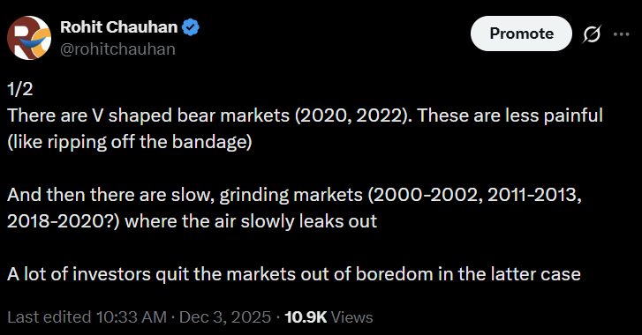
All bear markets are not the same

Slide 5
All bear markets are not the same
The ‘V’ shaped “Macro” bear market
The ‘U’ shaped “Valuation” bear market
This is a framework on how to think and navigate the market. It's not a formulae

Slide 6
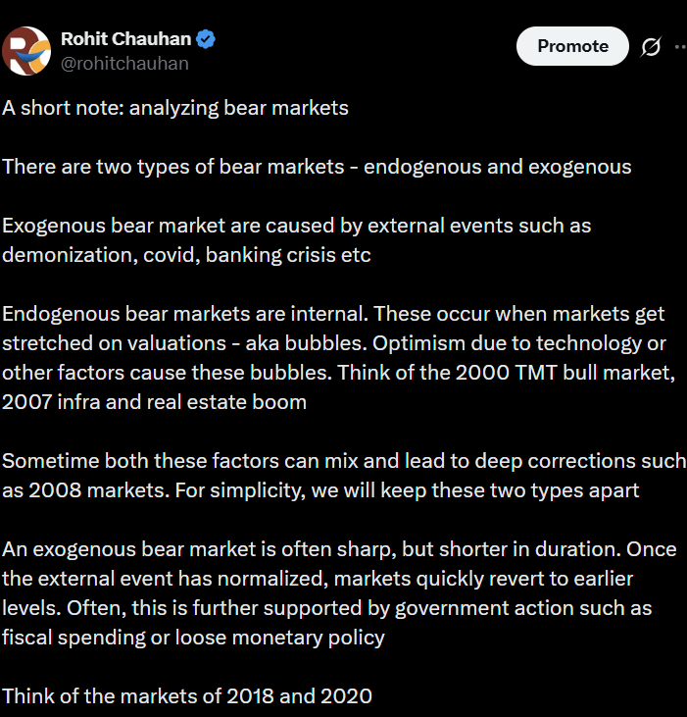
The V Shaped Bear
Caused by a macro event (exogenous)
Sharp dip and recovery as event dissipates
Recovery driven by liquidity/ Government action

Slide 7
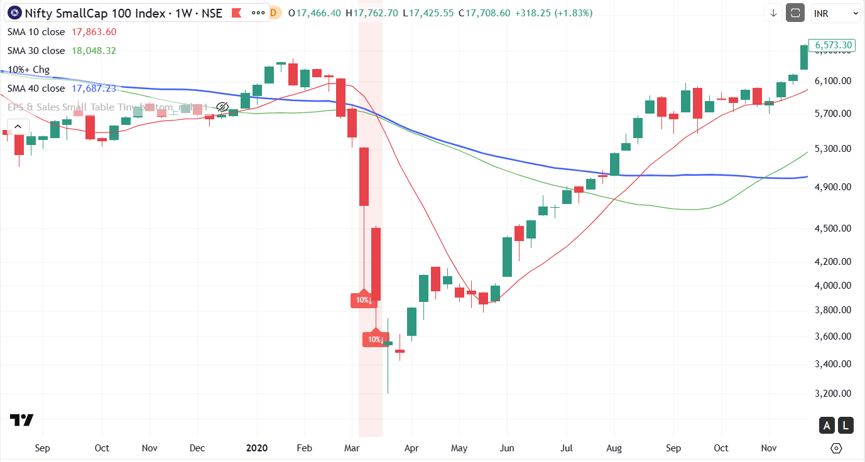
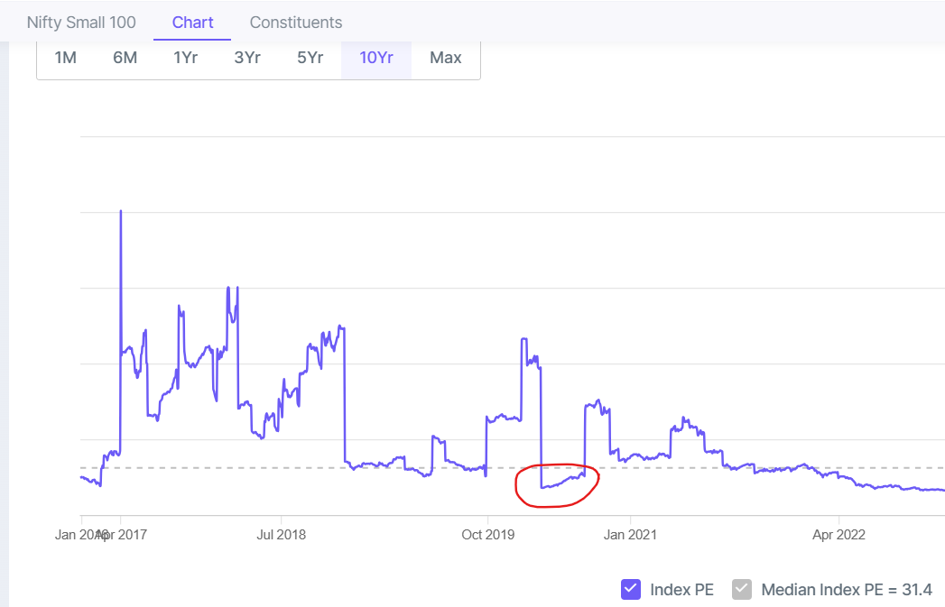
Covid Crisis - 2020
Global pandemic
Valuations at all time lows
Large Liquidity injections to revive the economy

Slide 8
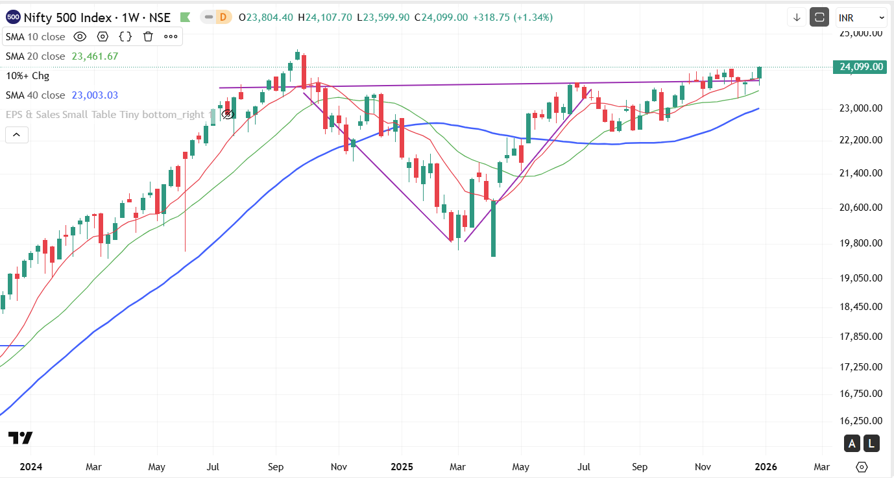
Trump Tariff Tantrum

Slide 9
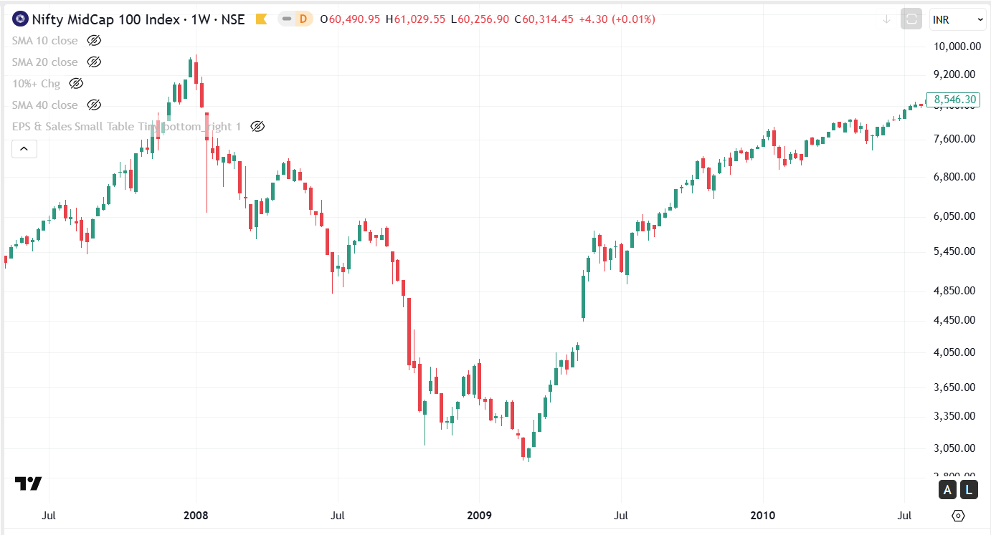
Lehman Crisis - 2008
First drop occurred on valuation which touched a peak in 2008
Great financial crisis caused the market to drop 60% after it had already dropped 45% from the peak
Large scale government intervention

Slide 10
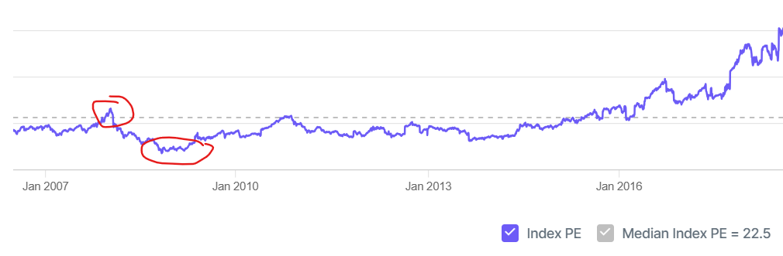
Sharp recovery from the bottom
PE < 10 at the low (all time low) in Oct 2008 – Feb 2009

Slide 11
How to approach V shaped markets
Have courage to buy at the bottom (when the world is falling apart)
Optimism that the event will resolve over time
Stock picking is not critical – Everything is bombed out
Speed is key, blink and you will miss a lot of gains

Slide 12
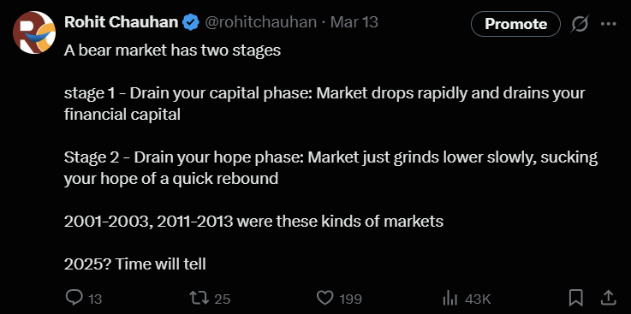
The grinding ‘U’ shaped bear

Slide 13
The grinding ‘U’ shaped bear
Endogenous (not linked to outside events)
Valuations get stretched due to over-optimism and reverts to mean
Slow, prolonged correction
Liquidity drains out as governments have no reason to respond

Slide 14
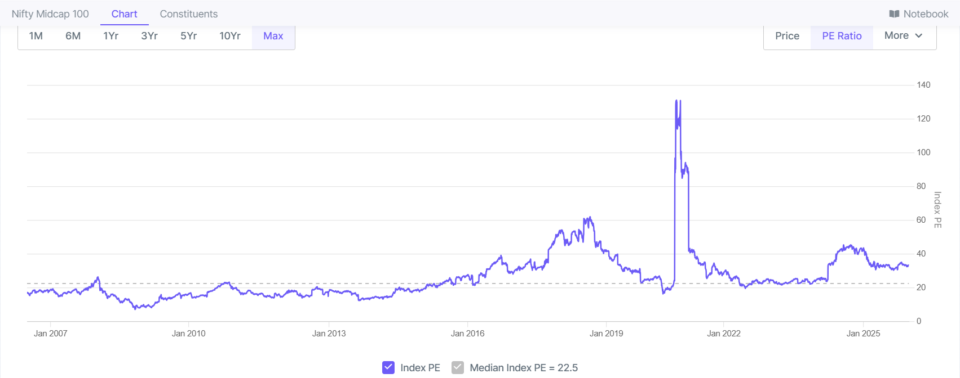
Why do they occur
Valuations are mean reverting
Business cycles

Slide 15
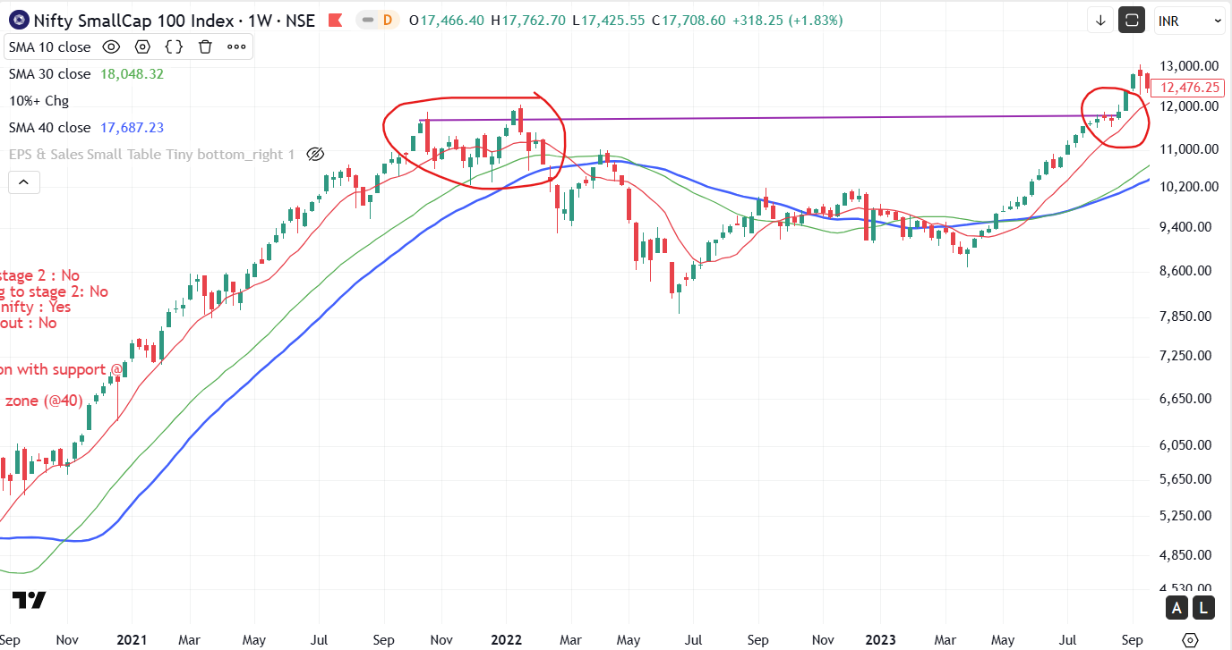
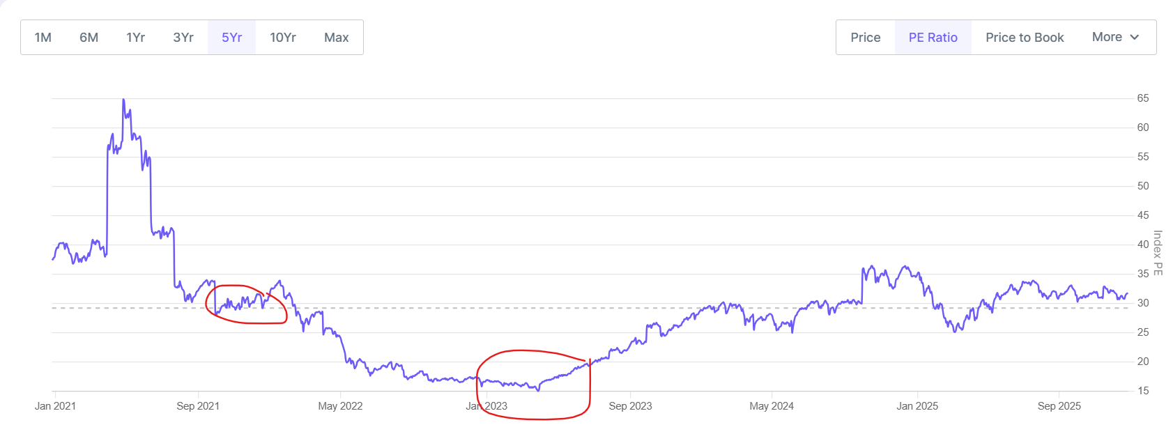
Tech Slowdown - Oct 2021– Aug 2023
Markets correct often without specific cause
Narratives built to explain drop

Slide 16
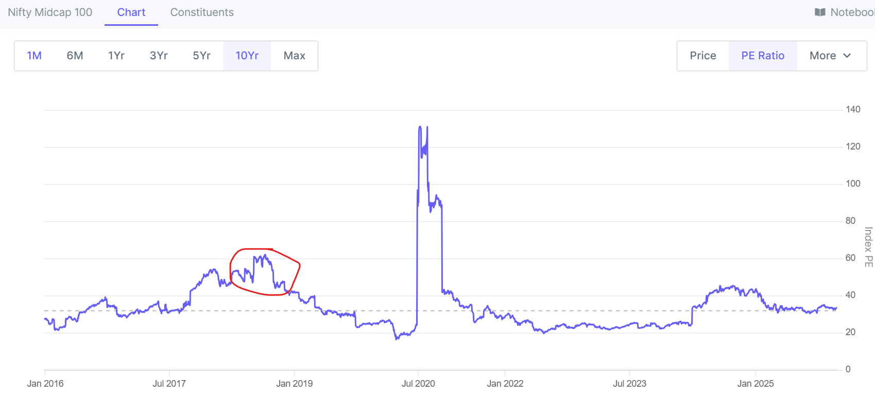
ILFS / NBFC issues - 2018
ILFS crisis, NBFC issues
Narratives built to explain drop

Slide 17
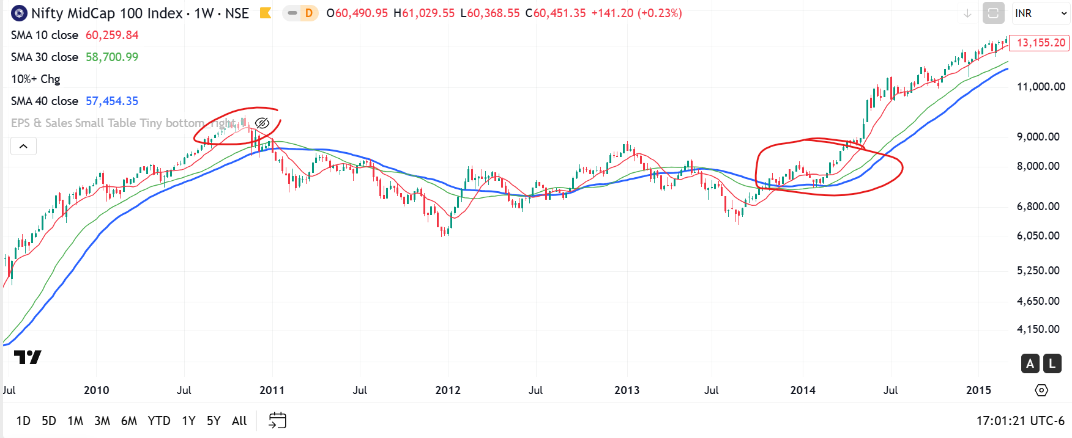
2011-2013 Eurozone slowdown
Common explanation: Eurozone risk-off → weaker foreign flows → rupee depreciation → more inflation/uncertainty → higher risk premium.

Slide 18
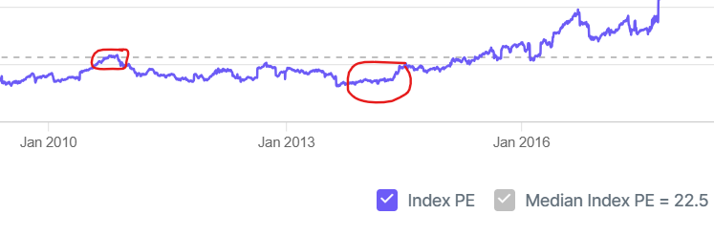
2011-2013 valuation correction
Valuations corrected from peak to trough during this period

Slide 19
What not to do
Avoid naïve historical projections such as bear markets last X months or go down Y% before recovery (No statistical validity)
Do not confuse with V shaped market and expect quick recovery
Momentum/Position trades do not work, until a new bull run starts

Slide 20
What to do
Have patience or else you will get ‘chopped up/grind down’
Look for the bottom’s up idea : Stock or sectors
Measure progress differently

Slide 21
Have Patience
High valuations revert to median via earnings growth or via price drop
They can overshoot on the downside
This can be long drawn process
This is similar to sector trends. A hot sector (Chemicals, Defense, Pharma etc.) took 4+ years to recover

Slide 22
Do bottoms up work
There is always a bull market somewhere
2018 : Quality
2022 -23 : Defense/PSU/Ship building/ Select companies
2025 : Gold and select companies
Identify companies which are reasonably priced and growing 15%+
Exit losers – The market will not bail you out
Identify sectors which are doing well
Work hard to generate alpha. There are no easy trends to ride

Slide 23
Examples
Ircon International, Cochin shipyard, Bector Foods
Company selling below median valuations (cheap)
Company growth > 15% or recovering
Part of a sector with tailwinds
Long term base breakout

Slide 24
Measure progress differently
Do not use price as a metric
Use the concept of portfolio earnings growth and portfolio valuation
Aim for highest possible earnings growth and lowest valuation @ portfolio level
Stock | EPS | Qty | Earnings | Amount | P/E | Earning Growth
A | 10 | 1000 | 10,000 | 2,00,000 | 20 | 15%
B | 12 | 1000 | 8,000 | 1,50,000 | 12.5 | 20%
C | 8 | 1000 | 12,000 | 2,00,000 | 25 | 30%
D | 14 | 1000 | 14,000 | 1,00,000 | 7.1 | 17%
 |  |  | 44,000 | 6,50,000 | 14.8 | 21%

Slide 25
Rational Optimist
Be a long-term optimist - The market always comes back

Slide 26
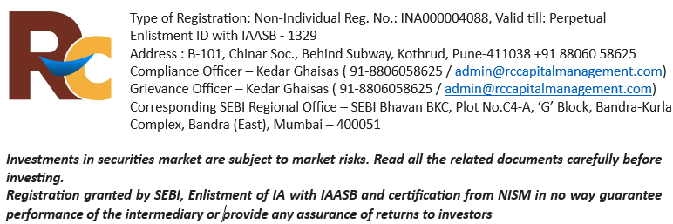
Contact Us
Site: rccapitalmanagement.com
Email: enquiry@rccapitalmanagement.com
Blog: valueinvestorindia.com

