Slide 1
WHY INFLATION MATTERS ?
Rohit Chauhan

Slide 2
DISCLAIMER
This is not investment advise and you should do your own research or consult a certified investment advisor to make a decision
We may hold the stock in our personal capacity and also in the portfolio of our advisory clients
We reserve the right to change our views and could sell or buy the stock accordingly

Slide 3
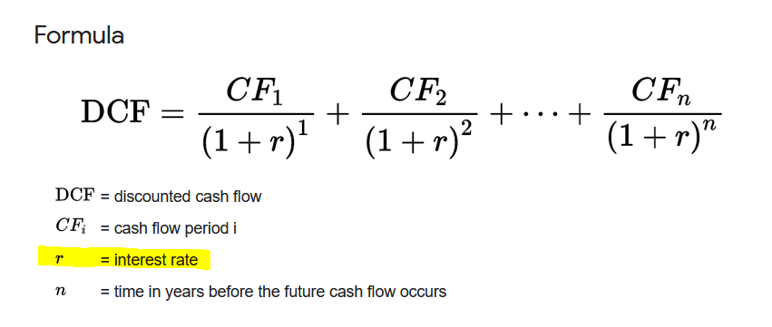
FIRST PRINCIPLES
Value of an asset is the discounted sum of future cash flows
Value depends on interest rates (r) and duration (n) or how far out is the cash flow
For same cash flow, higher ‘r’ leads to lower value
Value is sensitive to n

Slide 4
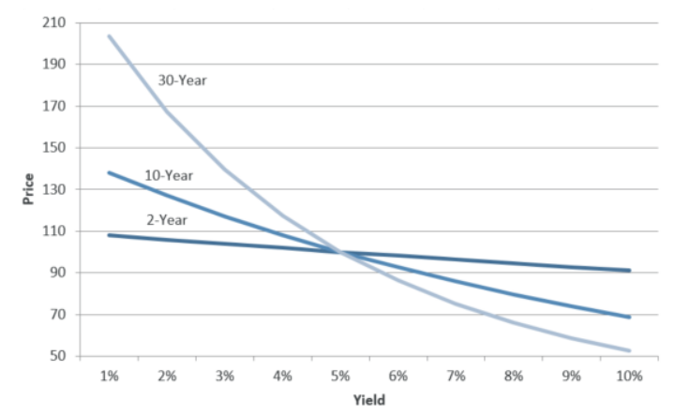
BOND PRICING
Bond prices fall with rise in interest rates
Bond with longer duration fall much longer than short duration
3% rise in interest rates leads to 45% drop in 30 year bond v/s 18% for 10 year

Slide 5
STOCKS ARE QUASI BONDS
Stock are valued same as bonds except duration and cash flow is not known (or is it?)
Price to earnings gives a rough guide to duration
  50 PE stock has greater duration and than 20 PE
  What about 100 PE
Companies with losses and high PE ? Double whammy
  They have a very high duration as their cash flows are anticipated long into the future ?

Slide 6
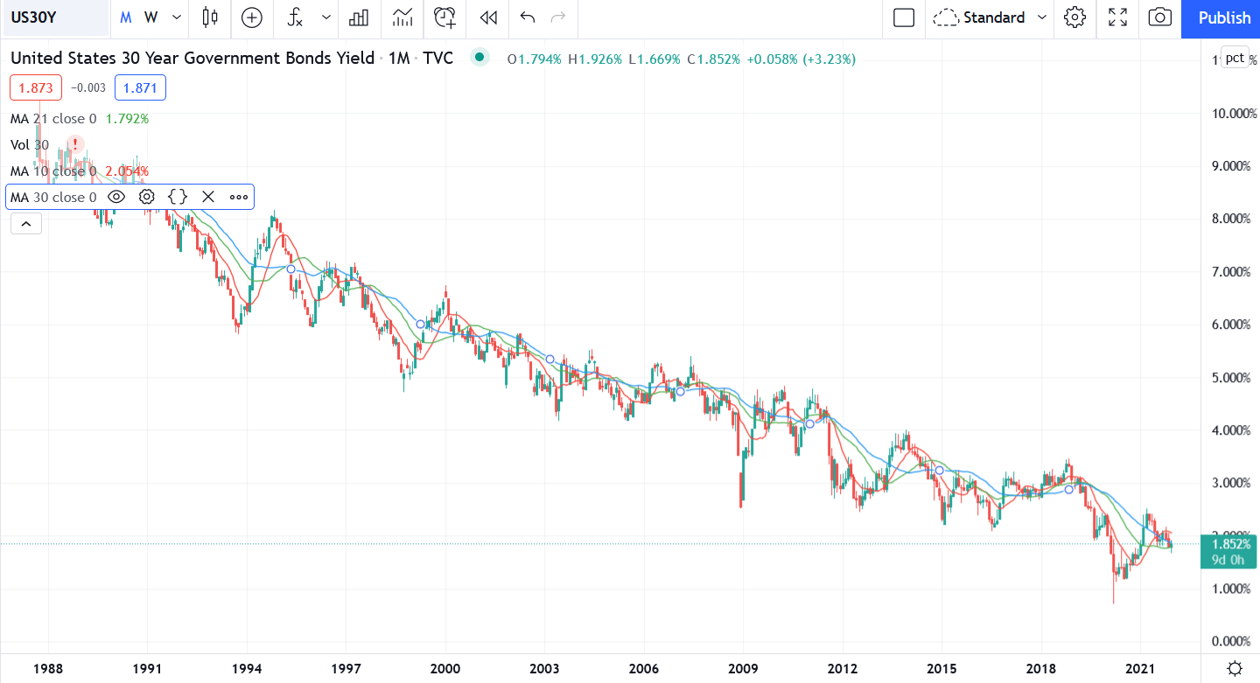
SUCKER FOR NARRATIVES
Covid accelerated the digitization of the economy (surely), but how much (who knows)
Interest fell during Covid and have been kept low
Interest have been falling since 1980! 40-year bull run

Slide 7
WHAT IF INTEREST RATES RISE
No one knows!
Valuations will be impacted IF they rise
Companies with the following characteristics will be most impacted
  High valuations with current losses (In the US such stocks are down 50%
  Quasi bonds : Companies with steady cash flows and high PE
  Everything else (impact will vary)

Slide 8
LIKE GRAVITY
Interest rates are like gravity
Valuations are like the Mass of an object
High interest rates exert more pull on stocks with high valuations. A company making losses is hurt the most

Slide 9
CONTACT
Twitter: @rohitchauhan
Blog: valueinvestorindia.com
Site: rccapitalmanagement.com
Email: rohit_chauhan@rcfunds.com
SEBI registered Investment advisor: INA000004088

